Slide 1
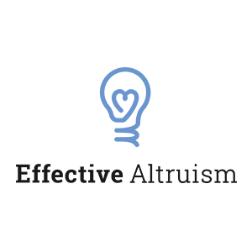
The Psychology of Effective Altruism Cognitive and emotional barriers to reducing sentient suffering and existential risk
Geoffrey Miller
Psychology Dept Colloquium
University of New Mexico, March 9, 2018

Slide 2


Effective Altruism (EA): A new social movement to do good, better
Principles:
Utilitarianism: increase utility for sentient beings – people, animals, future beings
Rationality: Use reason, evidence, & open debate to find effective, scalable interventions
Cause prioritization: focus on problems that are global, tractable, and neglected

Slide 3



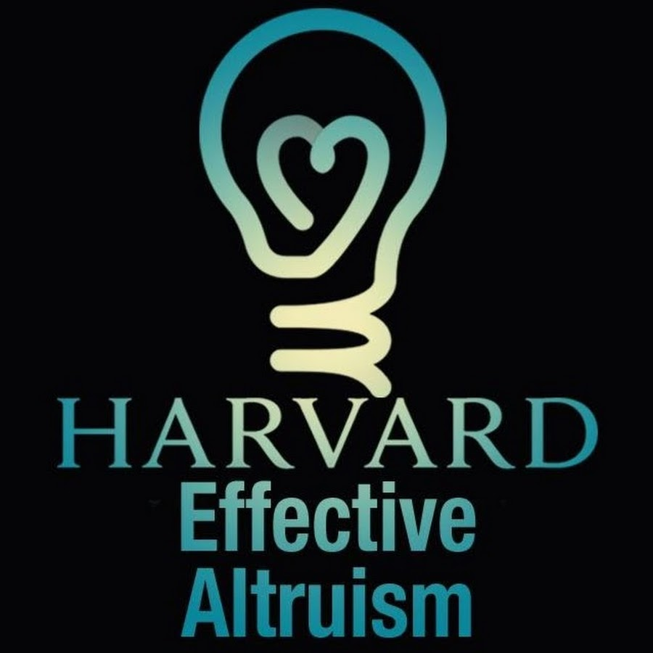
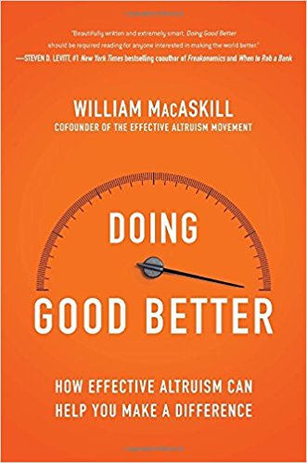
Effective Altruism as a movement
Founded in 2011 by Oxford moral philosophers Will MacAskill & Toby Ord, + Peter Singer
Fast growth among bright young rationalists: Oxford, London, Berlin, Bay Area, NYC, Sydney
Skeptical of traditional charities, causes, activism, policies, virtue-signaling
Open, transparent, rational, self-critical, evidence-based; strong public outreach
Updates ‘cause priorities’ often, given evidence
Prefer fast, informal communication with peers: blogs, tech reports, forums, conferences, & informal discussions (journals too slow)
Strategic about ‘movement building’ – optimize growth rate, recruitment strategies, PR strategies

Slide 4


A new(ish) research direction for me
15 publications since 1994 on moral virtues, evolution of altruism, research ethics
Got involved in EA in 2015; esp. 2016 sabbatical
10 talks since then on EA topics: SF, SD, NY, Puerto Rico, Chile, England, Australia
New paper in Biological Theory on existential risks of SETI/METI
Visiting this summer at FHI Oxford and/or MIRI Berkeley
New course this term: Psych 450/650: “The Psychology of Effective Altruism”

Slide 5








Main EA causes (currently)
Reduce global poverty
Reduce neglected tropical diseases
Reduce animal suffering
Reduce global existential risks

Slide 6

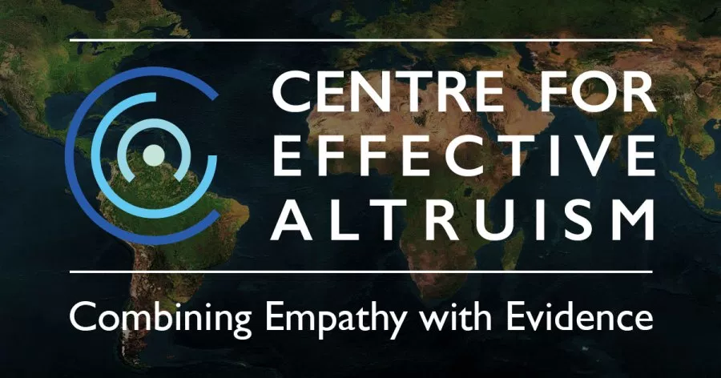




EA initiatives: New Academic Centers
Many are hiring now and offer research grants and great collaborators

Slide 7





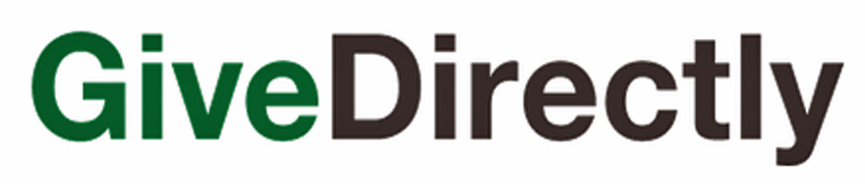





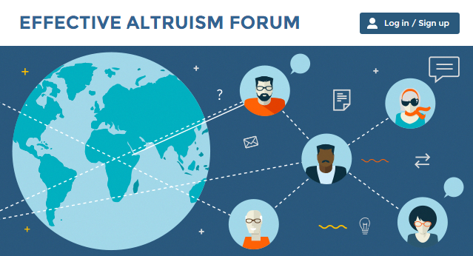

EA initiatives: Non-profits, foundations, etc.

Slide 8
EA impacts so far
Charity evaluation from ‘minimize overheads’ to ‘measure cost-effectiveness with RCTs’
Increased scope-sensitivity of smart donors
‘The Giving Pledge’ raised over $350bn from donors such as Bill Gates, Mark Zuckerberg, & Elon Musk
Shifted animal welfare activism strategies (work with industry rather than virtue-signaling)
Introduced new concepts like ‘earning to give’, ‘moral offsetting’, ‘cosmic endowment’
Giving EA career advice to many bright young people
Raised awareness of AI X-risks among researchers (Asilomar Principles, OpenAI), and leaders like Elon Musk, Sam Harris, Bill Gates, Max Tegmark, Sir Martin Rees, & Steven Hawking

Slide 9
Problems:
10 cognitive and emotional
challenges in EA
Solution:
Psychology?

Slide 10
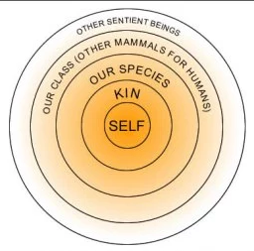

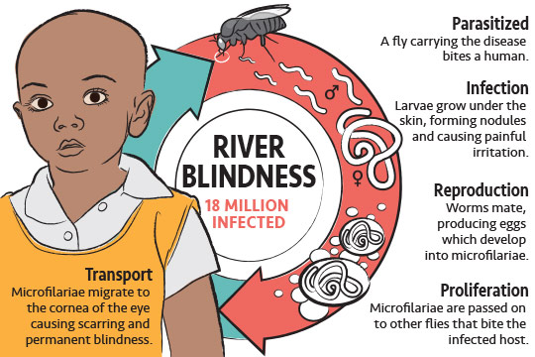
EA challenges 1: Selfish genes vs. the expanding circle
Kin selection → family
Reciprocal altruism → friends
Sexual selection → mates
Group selection → tribe
Humans show parochialism: favor domestic charities over global charities than may be 100x more cost-effective

Slide 11
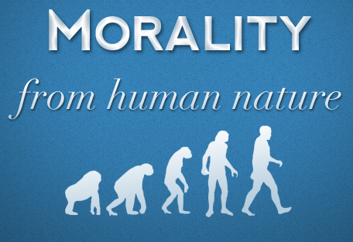

EA challenges 2: Descriptive vs. normative morality
Descriptive: what we actually do, given human nature (moral psychology)
Normative: what we should do ideally (moral philosophy)
Prescriptive: what we should try to do, practically (moral activism), given
our traits, resources, circumstances, knowledge
society’s laws, norms, technology, etc.

Slide 12
EA challenges 3: Scope-insensitivity in utilitarian judgments
Normative utilitarian analysis:
Total impact = multiply:
Scope: number of beings affected, current and future
Suffering: how much each being’s suffering could be reduced or well-being improved
Duration: how long each being would suffer without intervention

Slide 13
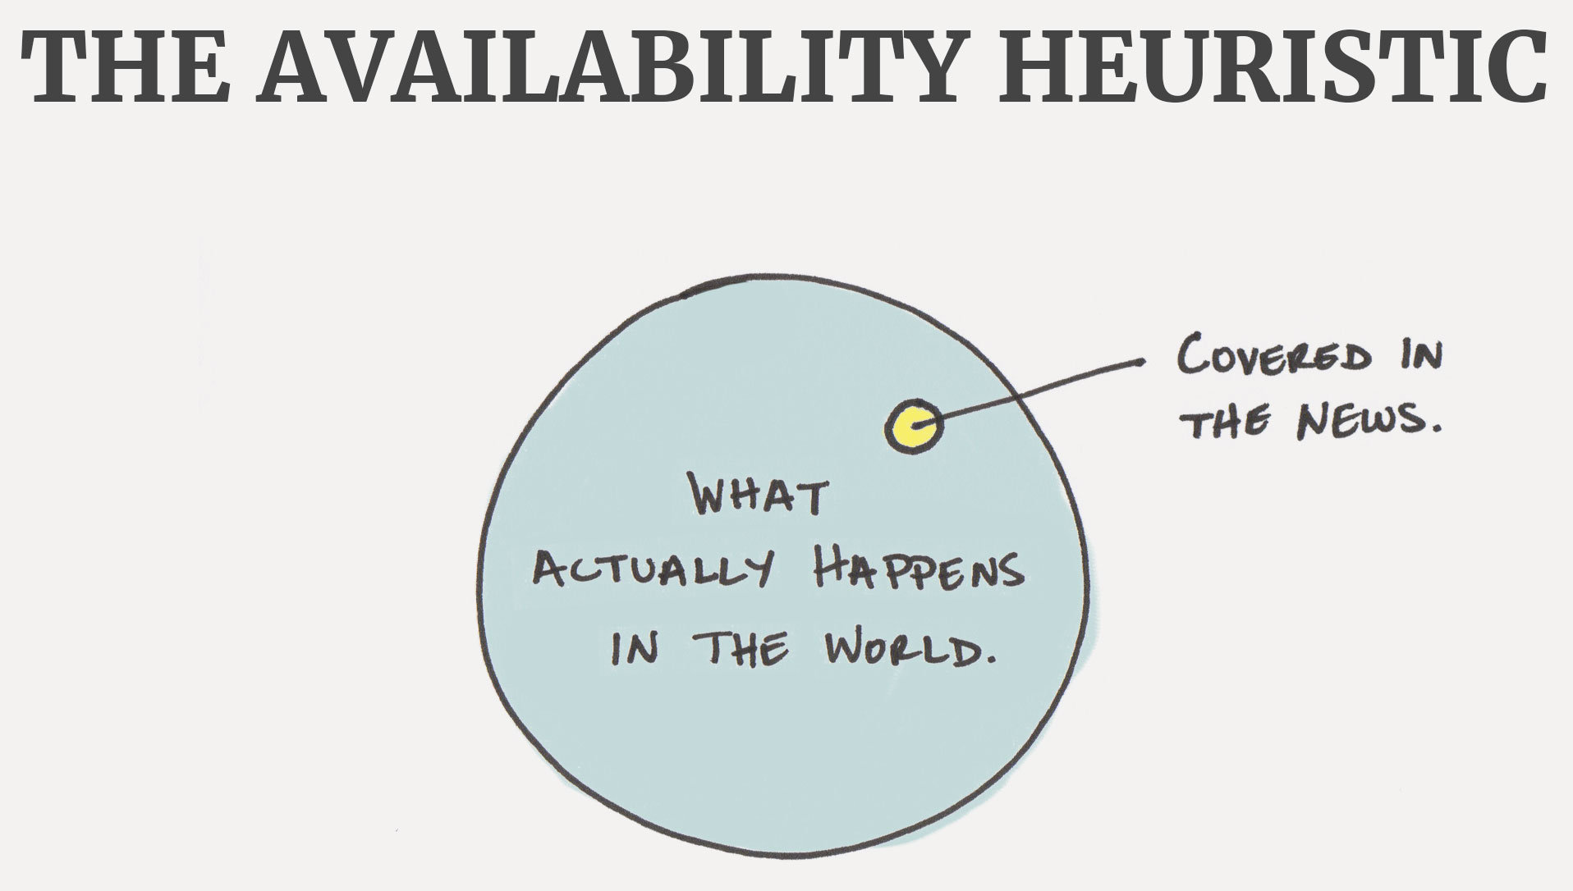

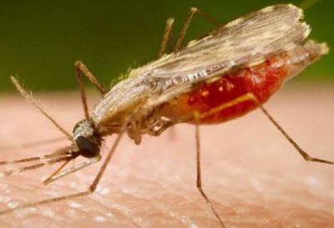
EA challenges 4: Availability bias in utilitarian judgments
Rifle homicides in US: 300/year, ~50 QALYs lost per death = 15k total QALYs lost
Malaria deaths worldwide: 450k/year, ~70 QALYs lost per death = 32 million QALYs lost
Malaria is about 2,000x more deadly than U.S. rifle homicides
Plus, malaria disability rates are higher; bed nets are cheap and work; no political controversy or constitutional law issues

Slide 14
EA challenges 5: Moral emotions don’t track utilitarian outcomes
Moral self-consciousness: shame, guilt, pride, embarrassment
Moral condemnation: contempt, anger, disgust, outrage
Other-suffering: empathy, sympathy, compassion
Other-praising: gratitude, awe
None evolved to track expected global long-term sentient utility

Slide 15
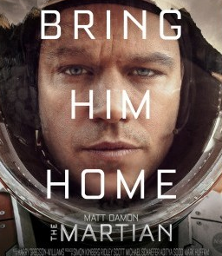

EA challenges 6: Moral instincts make utilitarianism counter-intuitive and repulsive
People
use empathy towards identified lives rather than compassion about statistical lives (Paul Bloom, 2016)
are disgusted by people who use utilitarian reasoning in moral dilemmas (Graham et al., 2017)
see utilitarians as sociopaths, and as unreliable exchange partners, friends, and mates (Everett et al., 2017)
$200 billion rescue?

Slide 16
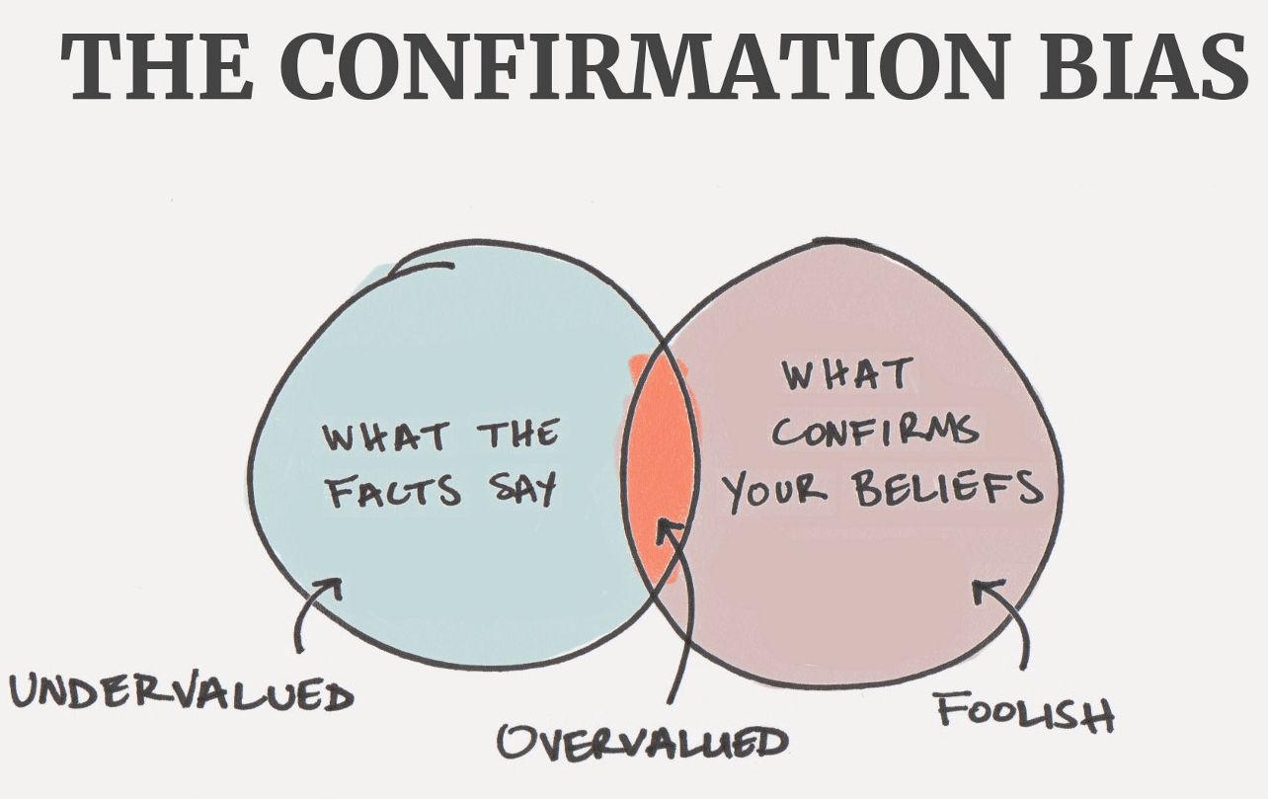
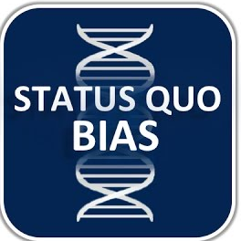
EA challenges 7: instinctive moral judgment don’t update very well
People:
show confirmation bias about their moral world-views (Plous, 1993)
show status quo bias, esp. in bioethics (‘wisdom of repugnance’ vs. the ‘reversal test’) (Kahneman et al., 1991)
can’t handle ‘moral uncertainty’ about moral principles (MacAskill, 2014)
are bad at Bayesian updating, counter-factual reasoning, and ‘steelmanning’ arguments

Slide 17
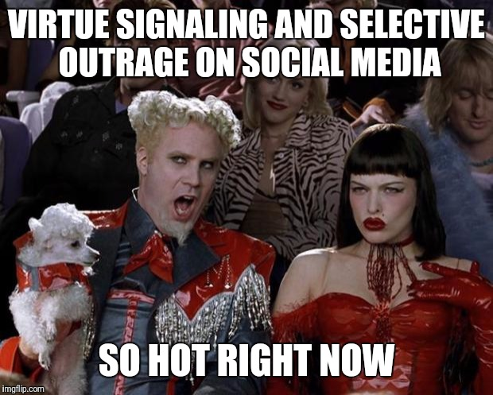

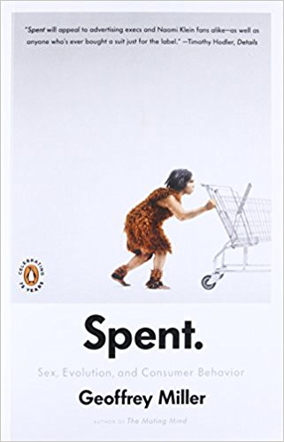
EA challenges 8: Virtue-signaling
Social & sexual selection favored virtue-signaling in humans (Miller, 2007)
Costly signaling logic: cost imposed on signaler (‘sacrifice’) was a more reliable cue of personality traits than benefit delivered to receiver
Virtue-signaling dominates charity giving, green consumerism, ethical investment, & social activism (Miller, 1999, 2009, 2013)

Slide 18
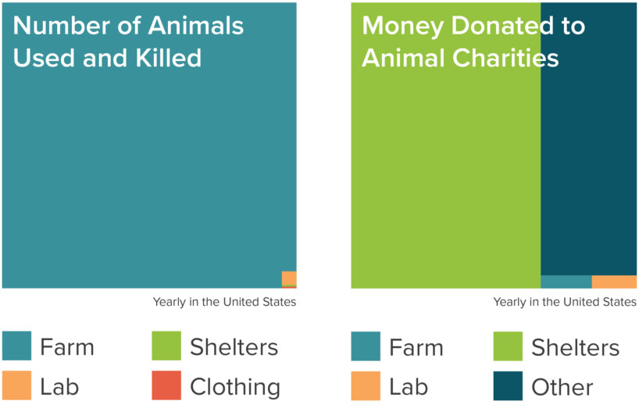


Animal welfare:
Practical compassion v. virtue-signaling

Slide 19
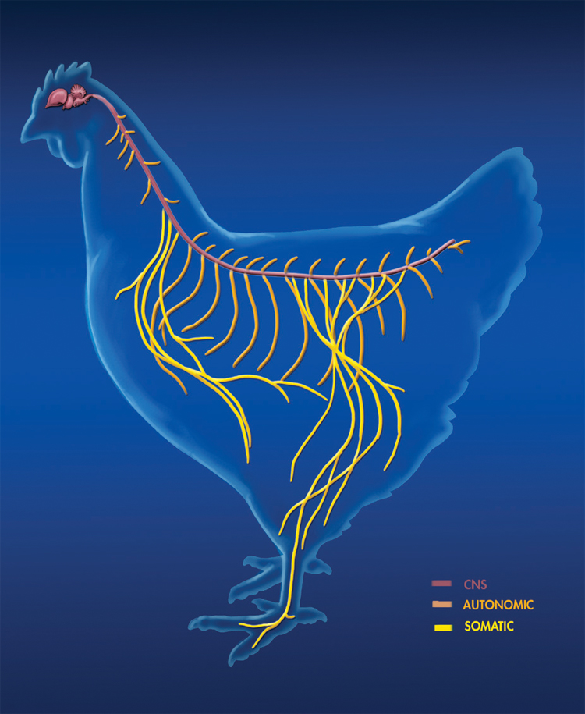
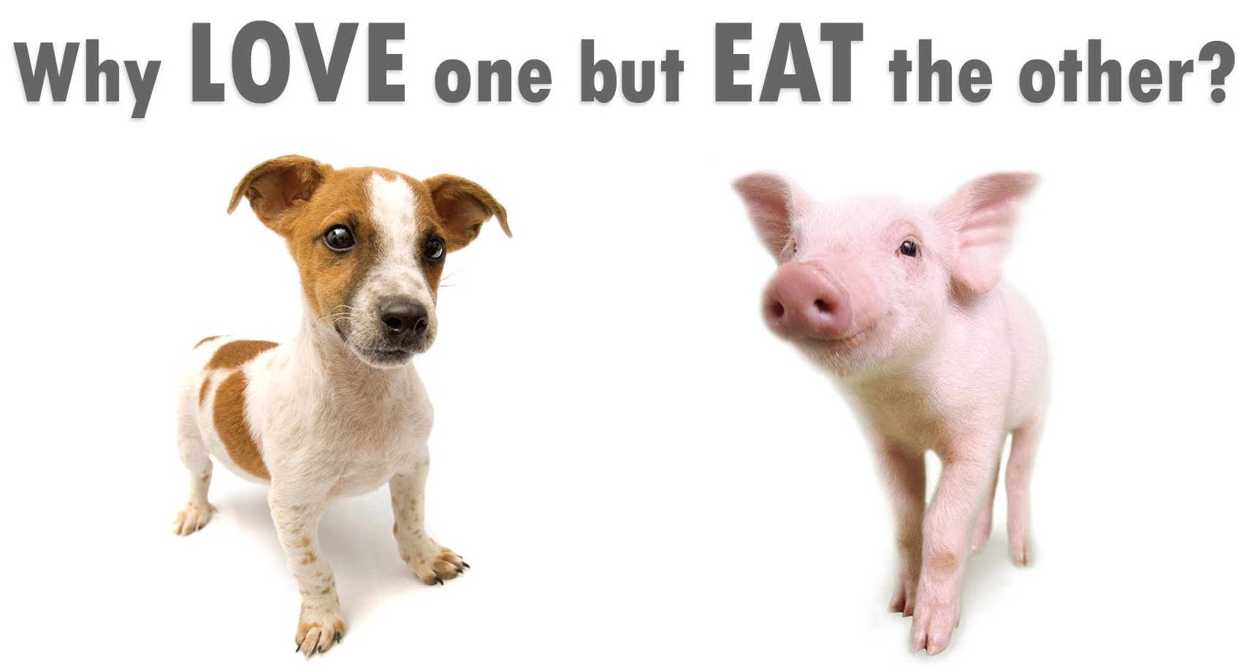
EA challenges 9: Theory of Mind fails for non-humans
People
show poorly-calibrated judgments of sentience across species – pigs vs. chickens vs. fish vs. oysters (chicken psych: Marino, 2017)
show arbitrary ‘speciesism’ in loving their pets, but ignoring the well-being of food animals (Caviola et al., 2018)

Slide 20
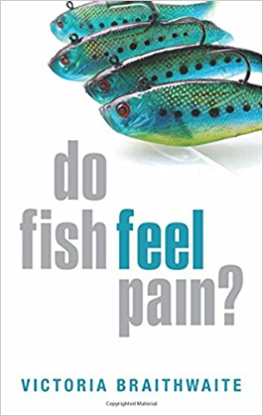
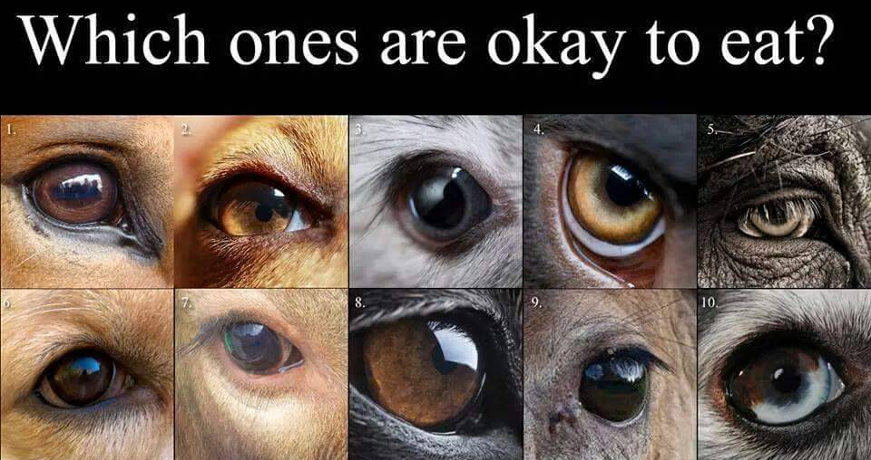

Animal sentience
Animal nervous systems evolve to track threats (fear, pain, suffering) and opportunities (desire, pleasure, well-being)
Sentience (the ability to feel & suffer) is common across species
Human evolved to fear some predators, hunt some game animals, care for some domesticated animals, and ignore the sentience of most animals

Slide 21
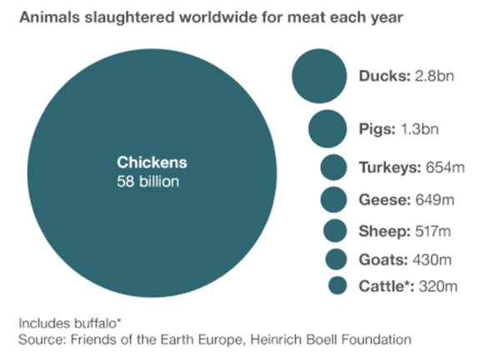
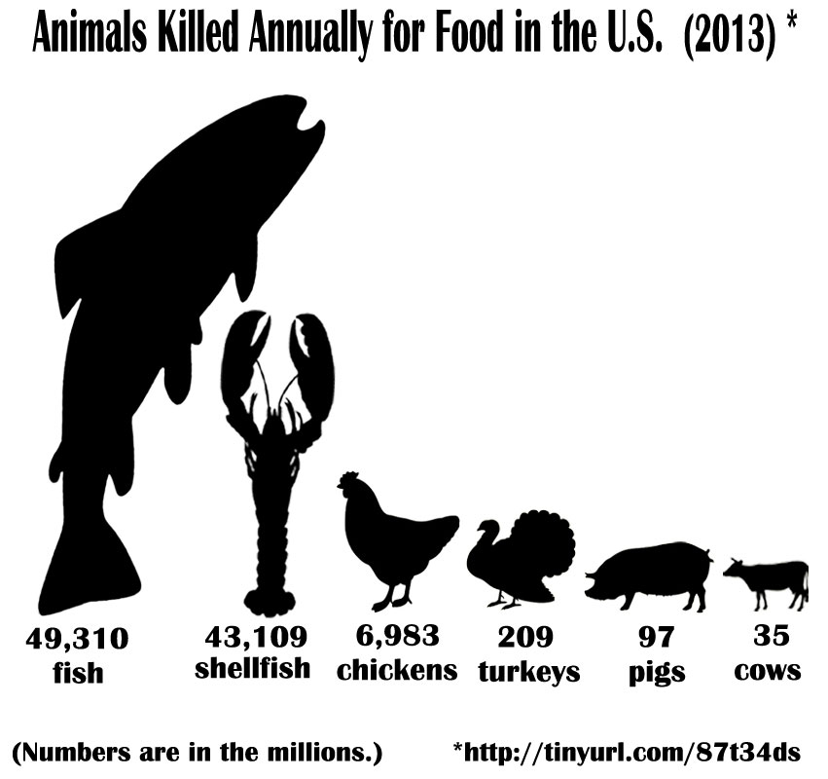
Animal welfare: The stakes
Human population: 7.6 billion
About 50 billion land animals per year raised & killed for food (mostly chickens)
About 1 trillion fish per year killed

Slide 22
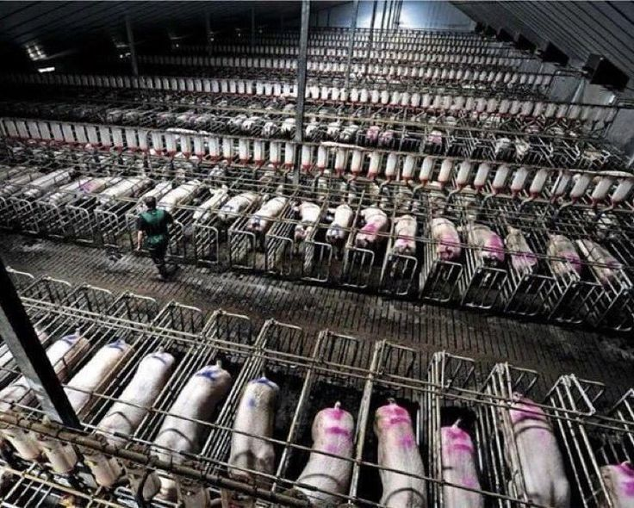
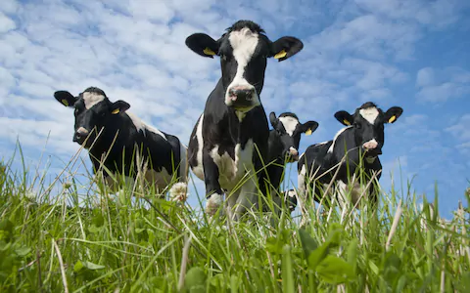
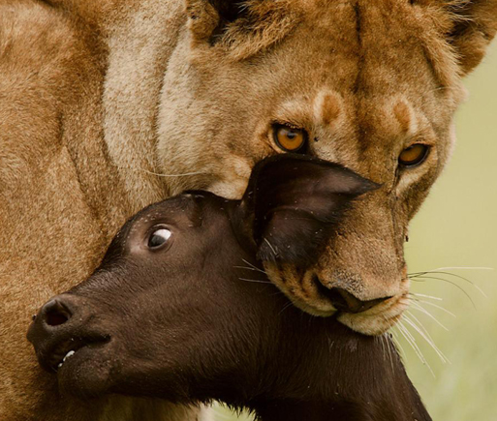


EA approaches to animal welfare
Important: factory farming, especially chickens, pigs, & fish
Less important: free range cows, animal shelters, lab experiments
Unknown importance: wild animal suffering?
Need more research on sentience and intervention effectiveness

Slide 23
EA challenges 9b: Theory of Mind fails for AI
People
anthropomorphize AI systems, so can’t judge how AIs will work or whether their values will be ‘aligned’ with ours
equate intelligence with embodiment, so can’t take AI risks seriously unless they’re in ‘killer robot’ bodies
can’t imagine a Superintelligence far beyond our abilities – project its likely personality traits, morals, and goals from human geniuses

Slide 24



EA challenges 10: Scope-insensitivity about long-term stakes
No prehistoric selection to distinguish tribal from planetary disasters
Hard to appreciate the cosmic stakes in existential risk (X-risk) problems (Bostrom, 2013; Yudkowsky, 2008)
Spatial scale: the colonizable supercluster (100,000 galaxies across 520m light-years)
Temporal scale: the aestivatable future light-cone (>20 billion years)
Computational scale: if we convert most baryonic mass in the light-cone into ‘computronium’ (Amato, 1991), how much sentience can we get?

Slide 25



Catastrophic vs. existential risks
Global catastrophic risks (GCRs): billions could die, but the species would survive
global warming, natural pandemics
Existential risks (X-risk): everybody could die; the species wouldn’t recover
Very low probability: asteroid strike, supervolcano
Much higher probability: nuclear war, engineered pandemics, AGI
extinction by bad AI wouldn’t just kill 7 billion current humans, but could prevent well over 10³⁵ future sentient lives from coming into being

Slide 26
Astronomical Stakes
Every year we delay colonizing Mars, we increase the chance of human extinction (Elon Musk)
Every second we delay colonizing the supercluster, we lose 10²⁹ potential future human-level sentient beings (Bostrom, 2003)

Slide 27
EA approaches to X-risk
Human-caused X-risks are thousands of times more likely per year than natural X-risks
AI, nuclear war, & engineered bioweapons are much more serious X-risks than global warming
AI is especially worrying, since it will be smarter than us, sooner or later
Current political systems neglect X-risks that the voters, policy wonks, and politicians don’t understand

Slide 28
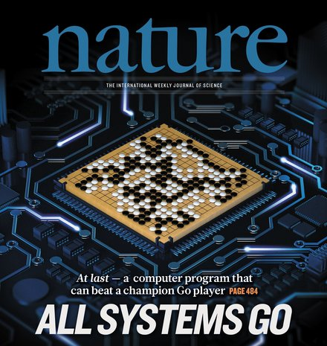

Worries about AI X-risk
Fast recent progress in machine learning
Huge corporate investment (Deepmind, Google, Facebook OpenAI, Microsoft, Apple)
Geopolitical arms races (China, US, Russia)
AIs will help run military, police, finance, energy, transport, medicine, food, education, news, social media, politics
‘Intelligence explosion’ from sub-human AI to human-level AGI to superintelligence
‘Value alignment problem’: can we ensure AIs have stable, human-friendly values & ethics?

Slide 29
Conclusions about EA
Worth attention: fast-growing, ambitious, empirical, full of bright young people
Mostly moral philosophers & computer scientists; psychology can improve EA’s effectiveness in understanding people, animals, and AI systems
Offers psychology more scalable, scope-sensitive ways to improve human welfare (vs. individual therapy)
Has a lot of money but needs more talent; offers a new source of research funding & new career paths
Questions?

